Slide 1
Lecture 1: Introduction to “Computer Vision”
Harbin Institute of Technology（Shenzhen）
Jingyong Su
sujingyong@hit.edu.cn

Slide 2
Today’s agenda
Introduction to computer vision
Course overview

Slide 3

A picture is worth a thousand words.

Slide 4
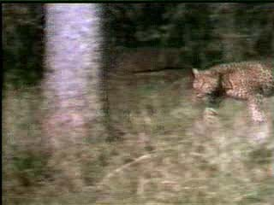
A word is worth a thousand pictures.
A HUNT

Slide 5
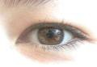
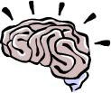
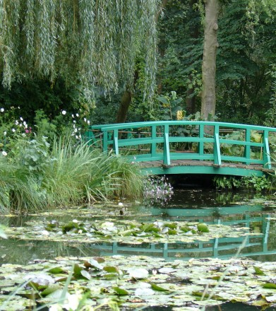
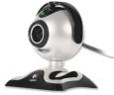

What is (computer) vision?
Image (or video)
Sensing device
Interpreting device
Interpretations
garden, spring, bridge, water, trees, flower, green, etc.

Slide 6
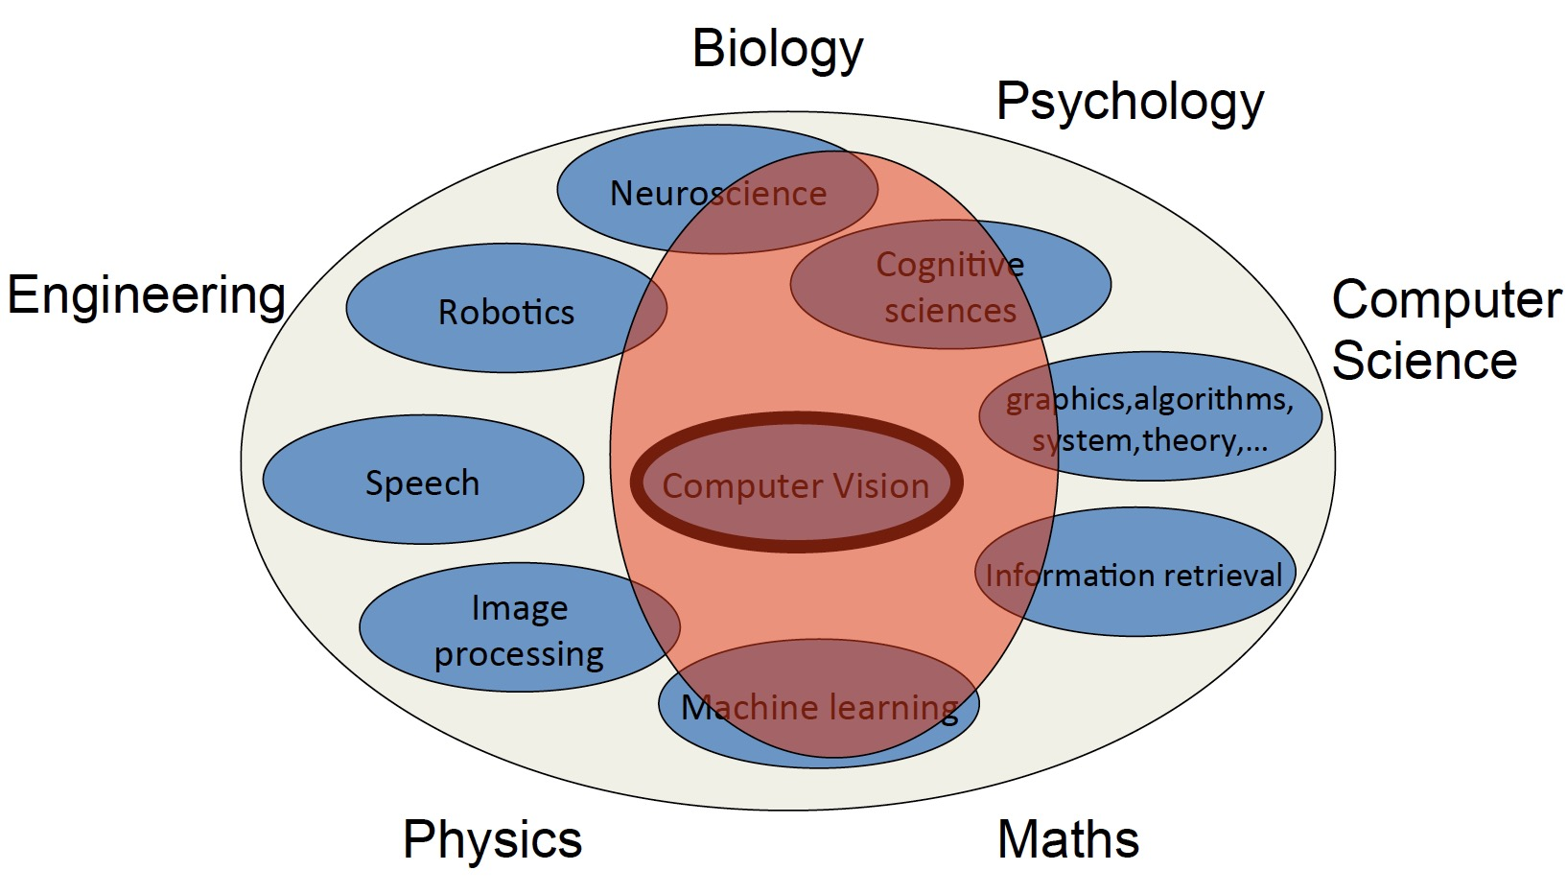
What is related to?

Slide 7
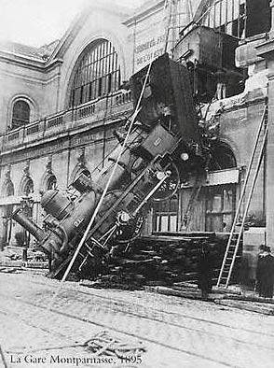
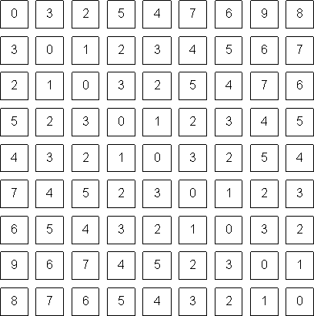
The goal of computer vision
To bridge the gap between pixels and “meaning”
What we see
What a computer sees

Slide 8
What is
(computer)
vision?
Image (or video)
Sensing device
Interpreting device
Interpretations
garden, spring, bridge, water, trees, flower, green, etc.

Slide 9
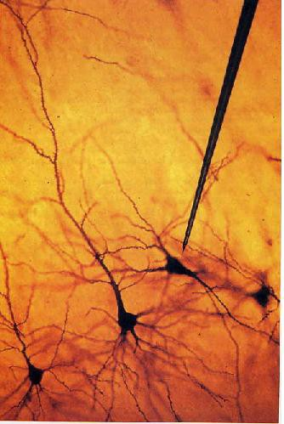
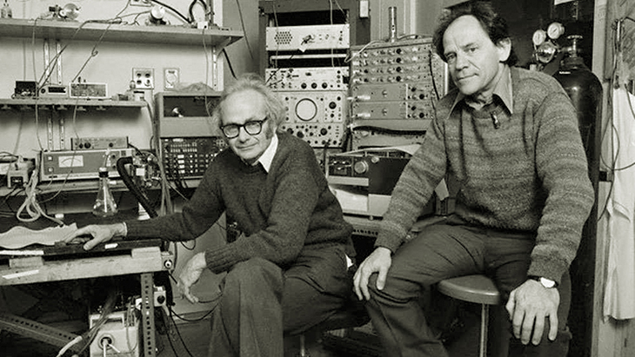
1981: Nobel Prize in medicine
Hubel & Wiesel at Harvard

Slide 10
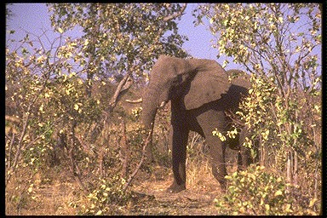
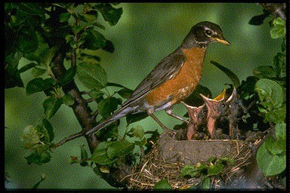
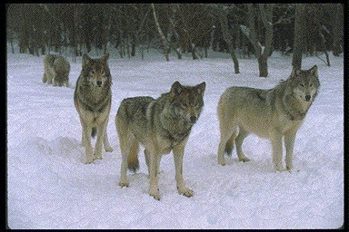
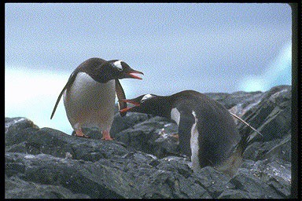
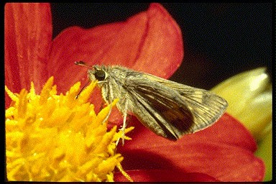
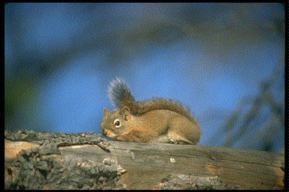
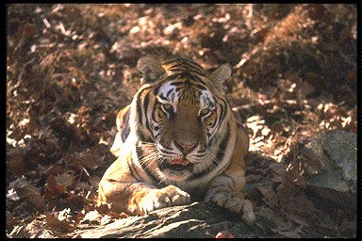
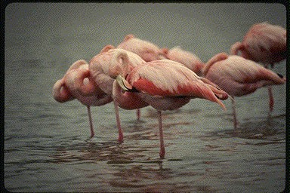
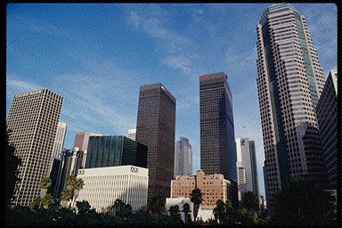
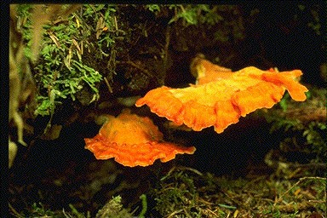
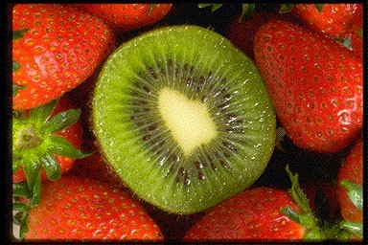
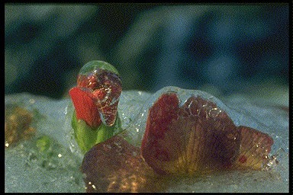
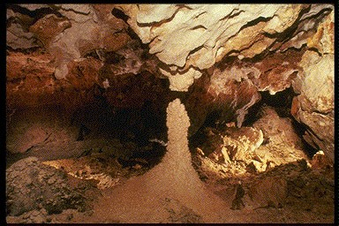
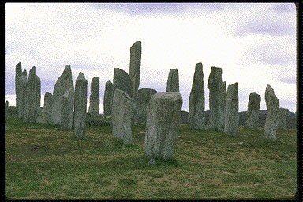
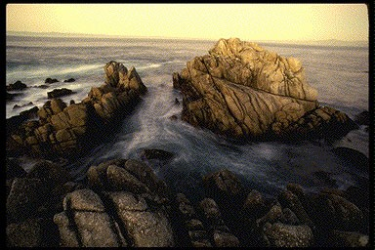
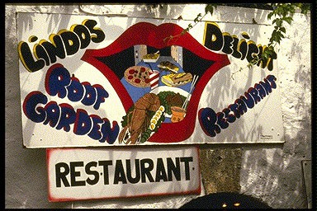
Human vision is superbly efficient
Thorpe, et al. Nature, 1996

Slide 11
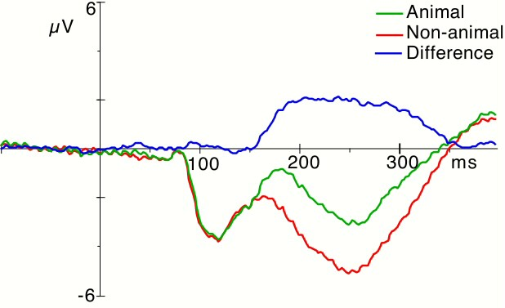

150 ms !!
Thorpe, et al. Nature, 1996

Slide 12
Fooling humans
However, this speed is obtained at the price of some drawbacks.
Changing small irrelevant parts of an image such as water reflection or background can go unnoticed because the human brain focuses on the important parts of an image.
If the signal is very close to the background, it can be difficult to detect and segment the relevant part of the image.

Slide 13
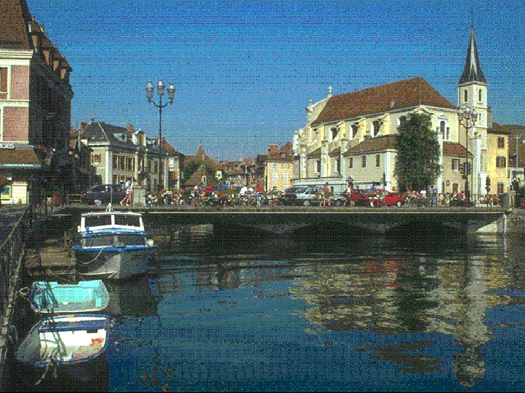
Change blindness
Rensink, O’regan, Simon, etc.

Slide 14
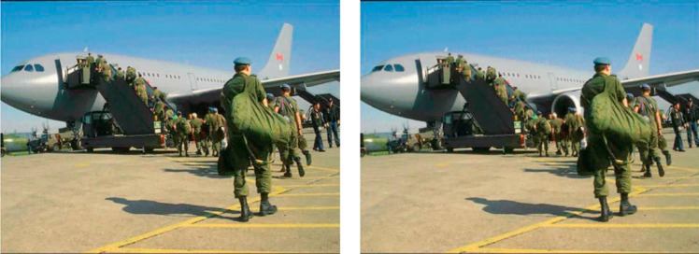
Change blindness
Rensink, O’regan, Simon, etc.

Slide 15
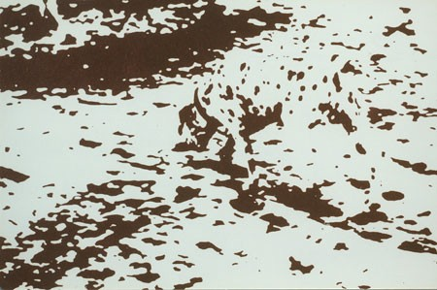
Segmentation

Slide 16
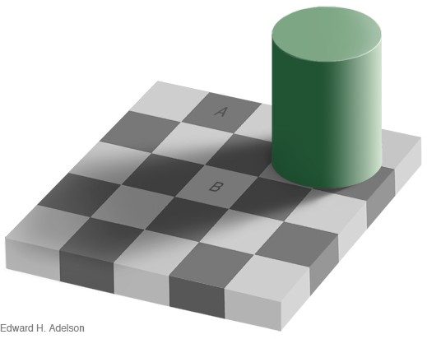
Perception

Slide 17

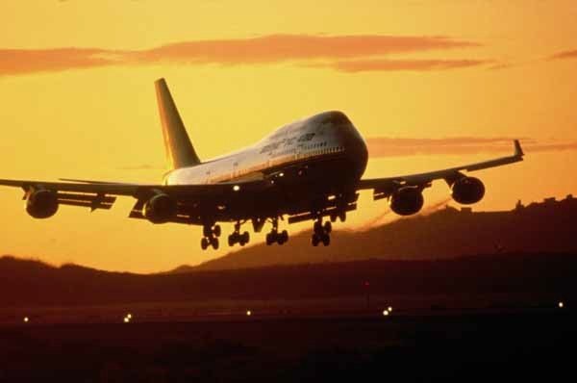

Slide 18
What is (computer) vision?
Image (or video
₎ Sensing device Interpreting device
Interpretations
garden, spring, bridge, water, trees, flower, green, etc.

Slide 19
The goal of computer vision
To bridge the gap between pixels and “meaning”
Source: S. Narasimhan

Slide 20
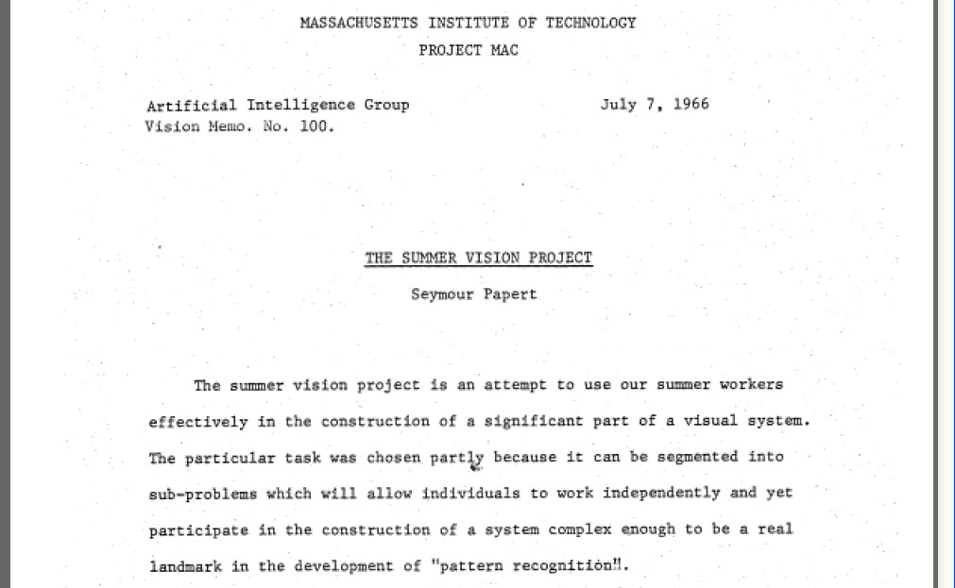
Origins of computer vision:
an MIT undergraduate summer project

Slide 21
What kind of information can we extract from an image?
Measurement
Semantic information

Slide 22
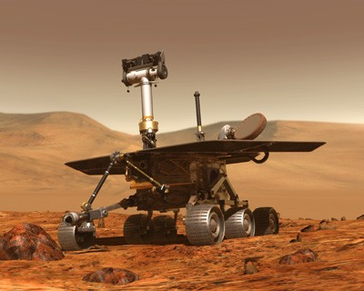
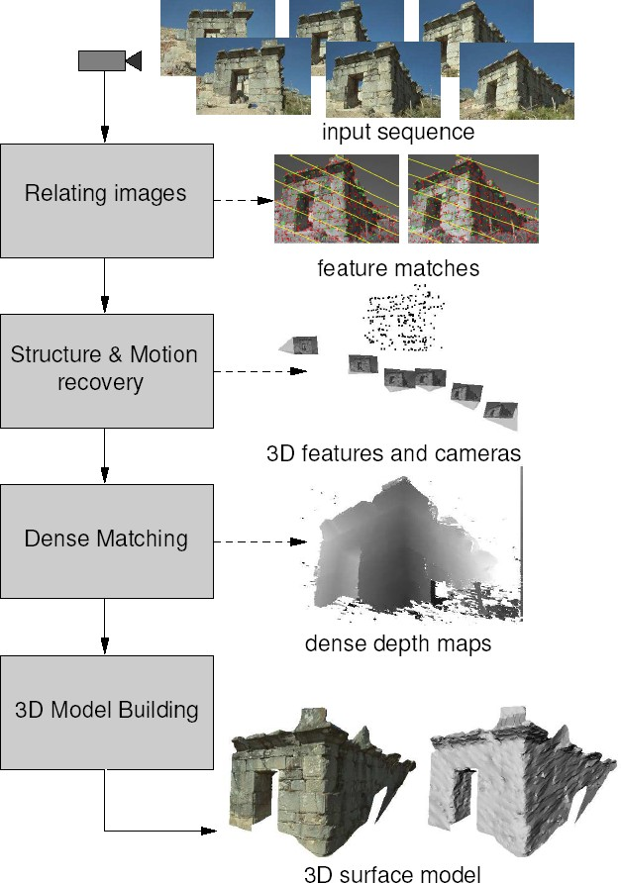
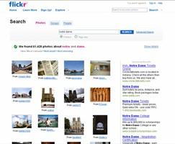
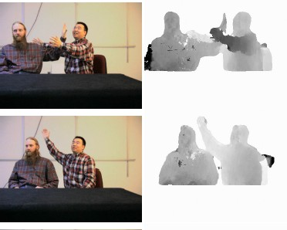
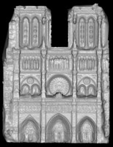
Vision as a measurement device
ernet photo collections
Pollefeys et al.
Goesele et al.

Slide 23
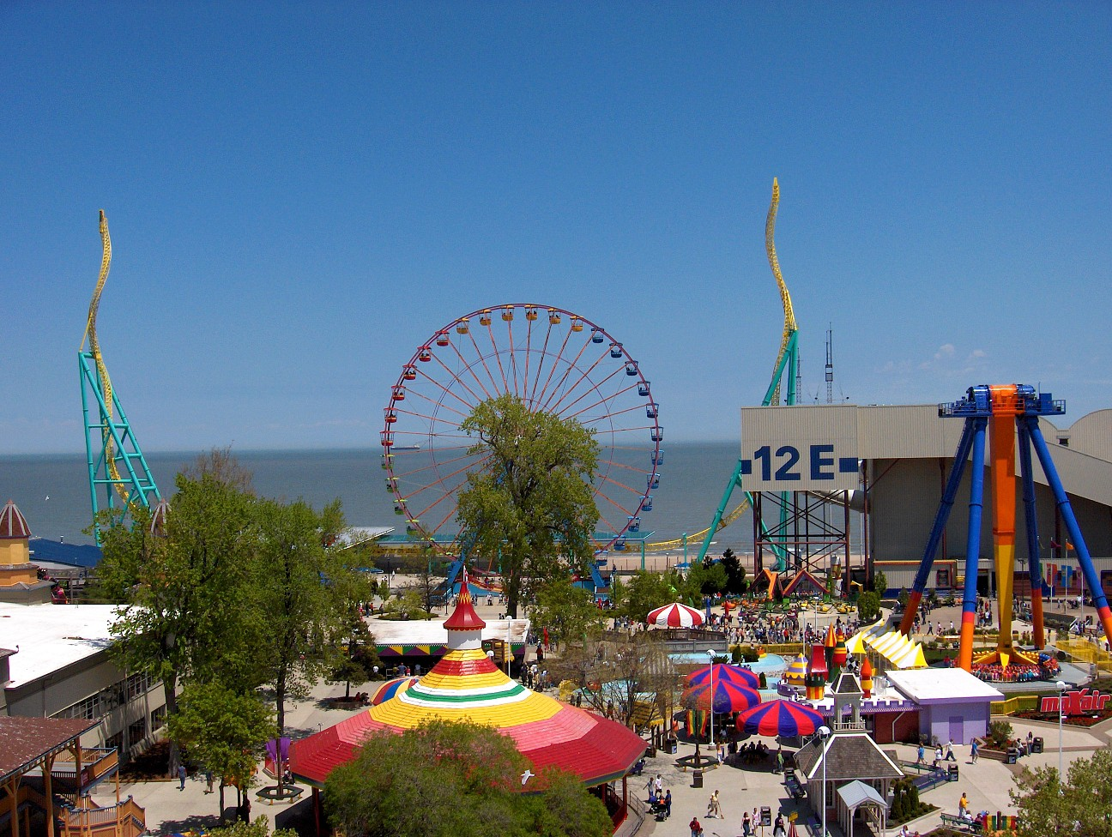
Vision as a source of semantic information
amusement park
sky
Objects Activities Scenes Locations Text / writing Faces Gestures Motions Emotions…
The Wicked Twister
Cedar Point
ride
Ferris wheel
ride
12 E
Slide credit: Kristen Grauman
Lake Erie
water
ride
tree
tree
people waiting in line
people sitting on ride
umbrellas
tree
maxair
carousel
deck
bench
tree

Slide 24
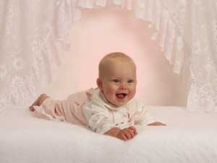
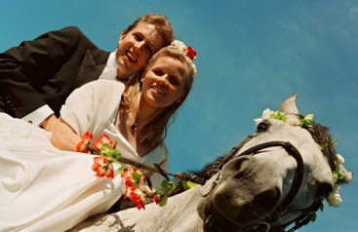
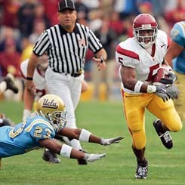
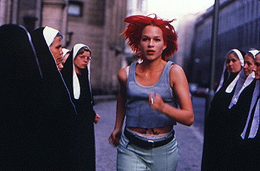
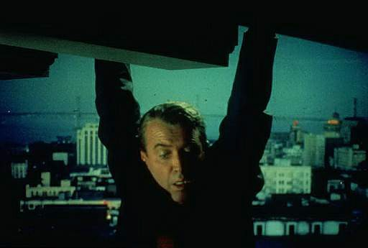


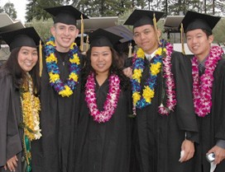
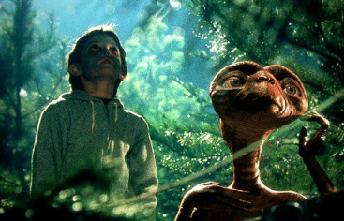


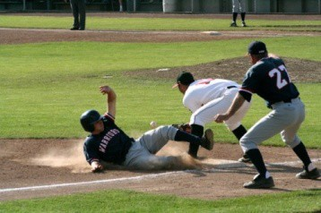






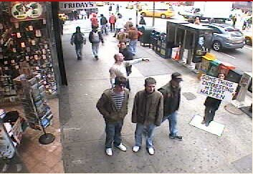
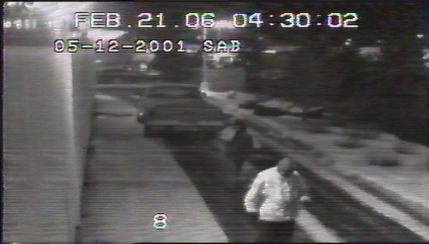
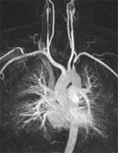











Why study computer vision?
Vision is useful: Images and video are everywhere!

Slide 25




Special eﬀects: shape and motion capture
Source: S. Seitz

Slide 26

3D urban modeling
Bing maps, Google Streetview
Source: S. Seitz

Slide 27

3D urban modeling: Microsoh Photosynth
hip://labs.live.com/photosynth/
Source: S. Seitz

Slide 28

Face detection
Many new digital cameras now detect faces
– Canon, Sony, Fuji, …

Slide 29


Smile detection
Sony Cyber-shot® T70 Digital Still Camera

Slide 30

Face recognition: Apple iPhoto software
hip://www.apple.com/ilife/iphoto/

Slide 31

Lipreading

Slide 32




Biometrics
How the Afghan Girl was Identiﬁed by Her Iris Patterns
Source: S. Seitz

Slide 33




Biometrics
Face recognition systems now beginning to appear more widely hip://www.sensiblevision.com/
Fingerprint scanners on many new laptops, other devices
Source: S. Seitz

Slide 34


Wide area surveillance

Slide 35


Optical character recognition (OCR)
Technology to convert scanned docs to text
If you have a scanner, it probably came with OCR sohware
Digit recognition, AT&T labs
License plate readers
http://en.wikipedia.org/wiki/Automatic_number_plate_recognition
Source: S. Seitz

Slide 36



Toys and Robots

Slide 37


Mobile visual search: Google Goggles

Slide 38


Mobile visual search: iPhone Apps

Slide 39

Automotive safety
Mobileye: Vision systems in high-­‐end BMW, GM, Volvo models
– “In mid 2010 Mobileye will launch a world's ﬁrst application of full emergency braking for collision mitigation for pedestrians where vision is the key technology for detecting pedestrians.”

Slide 40

Vision in supermarkets
LaneHawk by EvolutionRobotics
“A smart camera is flush-mounted in the checkout lane, continuously watching for items.
When an item is detected and recognized, the cashier verifies the quantity of items that were found under the basket, and continues to close the transaction. The item can remain under the basket, and with LaneHawk, you are assured to get paid for it… “

Slide 41



Vision-­‐based interaction (and games)
Sony EyeToy
Microsoft’s Kinect
Assistive technologies
Source: S. Seitz

Slide 42

Vision for robotics, space explora.on
NASA'S Mars Explora.on Rover Spirit captured this westward view from atop a low plateau where Spirit spent the closing months of 2007.
Vision systems (JPL) used for several tasks
Panorama stitching
3D terrain modeling
Obstacle detection, position tracking
For more, read “Computer Vision on Mars” by Maihies et al.

Slide 43
Today’s agenda
Introduction on computer vision
Course overview

Slide 44

Contacting instructor and TA
ALL EMAIL CORRESPONDENCES TO
hitcv2022@163.com
Instructor: Jingyong Su @ L1501
QQ Group: 795298894
TAs: Yang Yang, Rui Zhao

Slide 45
Topics (12 lectures)
Introduction (2)
Introduction to computer vision
Linear algebra primer
Pixels and Features (2.5)
Pixels and filters
Edge detection
Feature point extraction - SIFT
Regions of Images and Segmentation (1.5)
Clustering - K-means and mean shift
Motion and Tracking
Object Recognition and Face Detection(1)
Neural Networks (2)
Recurrent Neural Networks: RNN, LSTM (1)
Attention and Transformers (1)
Generative Modeling – GAN(1)

Slide 46
Your Grades
Attendance: 24% (2% per class)
Homework Assignment: 40% （10% each）
Only email the “.ipynb” file to hitcv2022@163.com
Procedures and results are required
Final Project: 36%

